Slide 1

Recent Advancements in the Statistical Analysis of Microbial Metagenomic Sequence Data
Nicholas J. Ollberding, PhD
Associate Professor
Division of Biostatistics and Epidemiology
nicholas.ollberding@cchmc.org

Slide 2
Goals
High level introduction to several methodologic issues impacting research into the role of the microbiome on human health
Improvements in OTU clustering algorithms
Log-ratio methodology to analyze compositional microbiome data
Approaches for analyzing longitudinal studies and meta-analyses
Topics important in improving applied microbiome research
Touch on the implementation of several methods using open-source software

Slide 3
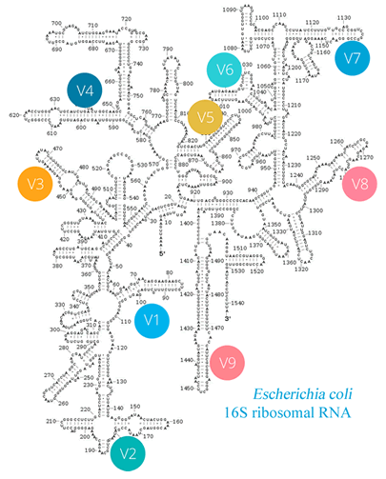
Part 1. 16S rRNA Amplicon Sequencing
Important use cases and limitations of amplicon sequencing
Conceptual difference between OTUs vs. ASVs
Shallow shotgun sequencing as possible alternative to 16S

Slide 4
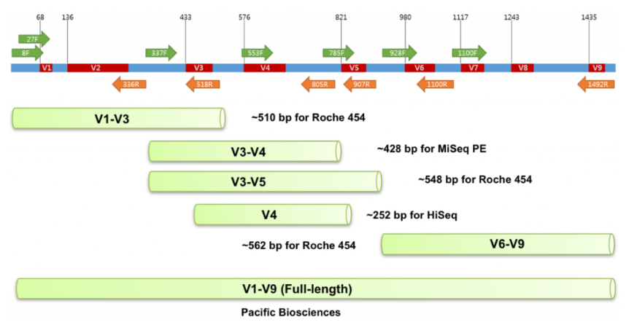
Why Consider Amplicon Sequencing?
Hypotheses specific to community composition
Low biomass environment or host-contaminated samples
Compare results to large existing public datasets
Cost-effective
Notes:
Mention PacBio and DADA2 shown good performance for full 16S gene region

Slide 5
Operational Taxonomic Units (OTUs)
Operational definition used to classify groups of closely related individuals (sequence similarity) Sokal and Sneath 1963
NGS technologies have low, but non-zero, error rates
Need an approach to resolve those errors when attempting to cluster sequences for downstream analysis
% similarity OTU clustering (97% OTU):
Deal with errors by clustering reads together that share > 97% similarity
Dereplicate and align, compute distance, cluster (agglomerative, greedy)
Returns subset sequences where all pairs of OTUs are <97% identical
97% does NOT reflect species

Slide 6
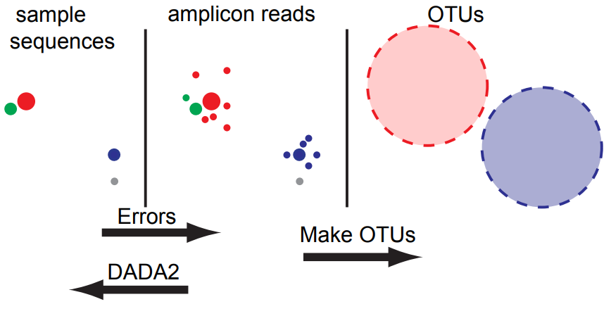
Operational Taxonomic Units (OTUs)
Problem 1: OTU obscures true biological variability
Problem 2: Generally have many rare clusters that share < 97% similarity
https://benjjneb.github.io/dada2/SMBS_DADA2.pdf
Notes:
This is a great slide by Ben Callahan at North Carolina State University that gives an excellent conceptual overview of the PTU clustering process…

Slide 7
Amplicon Sequence Variants (ASVs)
Unique sequence derived from amplicon sequencing
Still have errors and need to resolve…
Goal should be to report all correct biological sequences in the reads
Denoising algorithms attempt to achieve this goal by:
Dereplicating and aligning reads
Assume all read start from a single partition
New partitions only formed if given sequence passes some abundance and skew threshold where:
Abundance = is the number of times the read is observed
Skew = how different read is from potential parent sequence

Slide 8
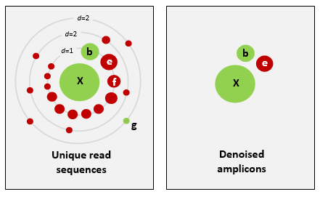
Amplicon Sequence Variants (ASVs)
Schematic of UNOISE approach. Green dots are true sequences. Red dots are sequencing errors. The size of the dot reflects the abundance. d reflects the number of divergent bases from X. B and E have low divergence, but high abundance, so form new partitions. Others have insufficient abundance and divergence to form new partitions. G is errantly not allowed to form new partition and highlights the limits of resolving rare variants. E shows example of how false positives are formed.
Edgar, bioRxiv, 2016.

Slide 9
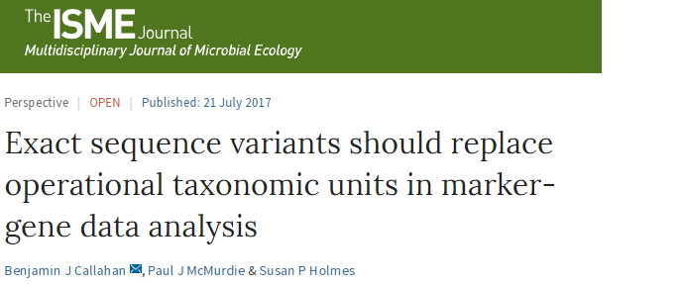
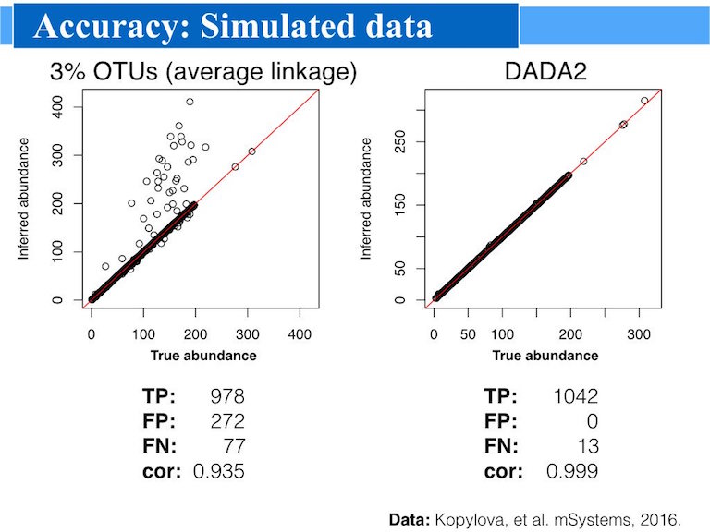
Improved sensitivity and specificity
Single nucleotide resolution
More refined taxonomic classification
Conceptually clearer
Scales well to large datasets
https://benjjneb.github.io/dada2/index.html

Slide 10
16S Abundance and Amplification Bias
16S copy number variation
Prokaryotic genomes contain ~1 to 10 copies of the 16S rRNA gene
Strains with more copies become artificially abundant
Primer mismatches
PCR amplification degraded if template has mismatches with primers
Order of magnitude suppression for each mismatched position
Uneven mixing of degenerate primers
Biases can occur due to unevenness in the primer mixture
Small biases amplified by PCR (i.e. 10% bias after 20 rounds = 1.1²⁰ = ~7x )
16S read abundance does well not correlate with species abundance
R. Edgar, https://drive5.com/usearch/manual/amplification_bias

Slide 11
How to Interpret 16S Amplicon Abundances?
Relative abundance of 16S rRNA gene copies…
Given a specific hypervariable region and choice of primers
PCR amplification, depth of sequencing, instrument error rate
Error correction
Cross-talk, contamination, wet-lab approaches, etc…
Wise not to assume reflects true underlying relative abundance
However, bias not expected to differ based on outcome
So tests for differences across samples expected to remain valid

Slide 12

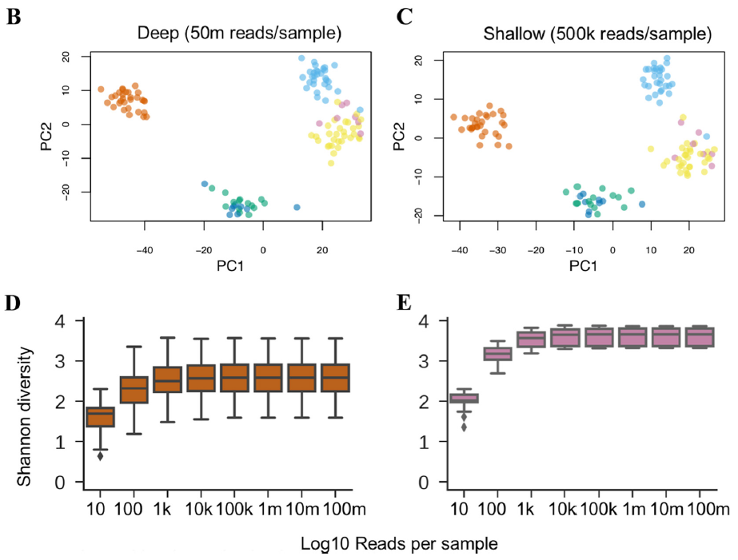
Shallow Shotgun Metagenomics
Shallow (500k/sample) well-approximated deep shotgun (2.5B)
Alpha-diversity and beta-diversity
Species and functional composition
Biomarker discovery
Illumina HiSeq with multiplexing modifications
$99 sample at 2M reads/sample
Limitations:
Too shallow for assembly
Too shallow to call strains
Deeper seq. for taxa < 0.05% rel. abund.
Database dependent (oral, fecal)
Hillmann, mSystems, 2018
Notes:
D = stool E = oral (gingival plaque)

Slide 13
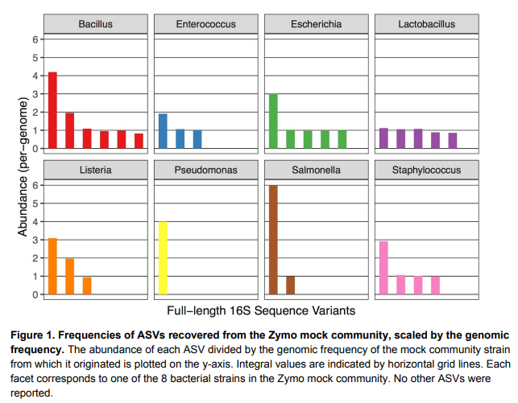
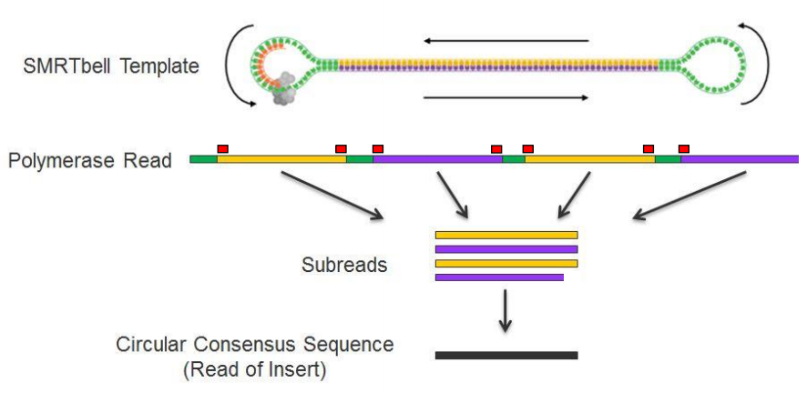



Full-Length 16s rRNA Gene Sequencing
$$+$$
˭
near perfect accuracy on Zymo and HMP mock communities
Callahan, bioRxiv, 2018

Slide 14
Part 2. CoDA for Microbiome Data
Why microbiome data are compositional and what are the implications
Approaches to account for compositional data
CoDA workflow for microbiome data

Slide 15
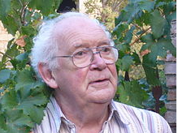
Interpreting Compositional Data
“There is a tendency in some compositional data analysts to expect too much in their inferences from compositional data” – John Aitchison
Thought experiment:
Planter that contains: 18 kg H₂O, 12 kg soil, 6 kg seed (truth)
Sample at night: x_{night} = (0.5, 0.33, 0.17)
Sample in morning: x_{morning} = (0.67, 0.22, 0.11)
Proportions consistent with:
36 kg H₂O, 12 kg soil, 6 kg seed – it rained last night (H₂0 ↑)
18 kg H₂O, 6 kg soil, 3 kg seed – wind blew out soil and seed (soil ↓, seed ↓)
27 kg H₂O, 9 kg soil, 4.5 kg seed – wind and rain! (H₂0 ↑, soil ↓, seed ↓)
Compositions provide relative information and cannot determine absolute changes without external information
Aitchison, Mathematical Geology, 2005.
Notes:
Have to be interpreted relative to basis

Slide 16
Compositional Data in a Nutshell
Vectors of non-negative components showing relative importance of parts in a total
Total sum is an artifact of the sampling procedure
Scale invariant - doesn’t matter if components represented as proportions, percents, ppm, etc.
No individual component can be interpreted in isolation
Carries no information on the absolute increment/decrement of components
Sample space (set of possible values) is constrained by the unit sum
Components are not free to vary individually
Tolosana, Compositional Data in a Nutshell, 2008.

Slide 17
Why Do we Care?
Compositional data violate assumptions of standard statistical tests
Unit sum constraint induces spurious correlations (Pearson 1897)
Independent taxa can appear correlated when working with relative abundances
Constraint distorts multivariate patterns of variability
Ordinations distorted and can change for given sub-compositions
Components are not independent
Difficult to form meaningful hypotheses in regression/ANOVA for predictor components in a mixture
Inflated error rates for compositional outcomes
Xia et. al, Statistical Analysis of Microbiome Data with R, 2018.
Notes:
Compositional data exist in a subspace of the Euclidian geometry referend to as the simplex
This has important consequences

Slide 18
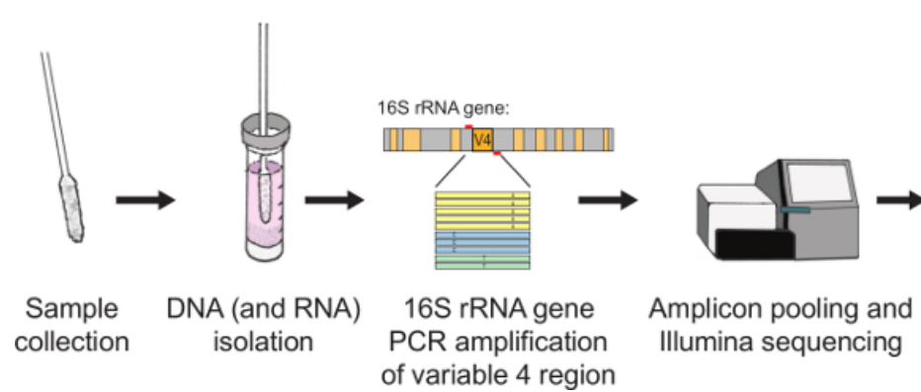
NGS Returns Compositional Counts
Microbiome experiment
Extract DNA and generate library
Sequence a random sample from library
Total reads per sample equals:
Total available reads
Divided by number of samples multiplexed
Counts carry only relative information
Provide no information on absolute increment/decrement
Precisely definition compositional data
Need methods for this compositionality
Anahtar et. al., J. Vis. Exp., 2016

Slide 19
Accounting for Compositional Data
Standardize read counts using external spike-in to recover ratios of absolute abundances
Normalize counts to account for variation in sequencing depths
Calculate “size factor” for each sample as an estimate of standardized library size
Divide the read counts by size factor to produce normalized data
Works well when most taxa are invariant to the condition under study
Simply converting to proportions does not remove compositional constraint
Log-ratio transformation to move from constrained to Euclidian space
Change in coordinate system to remove compositional constraint
Ratio of each taxa relative to some basis on the logarithmic scale
CLR: ratio of each component to geometric mean of all others on log scale

Slide 20
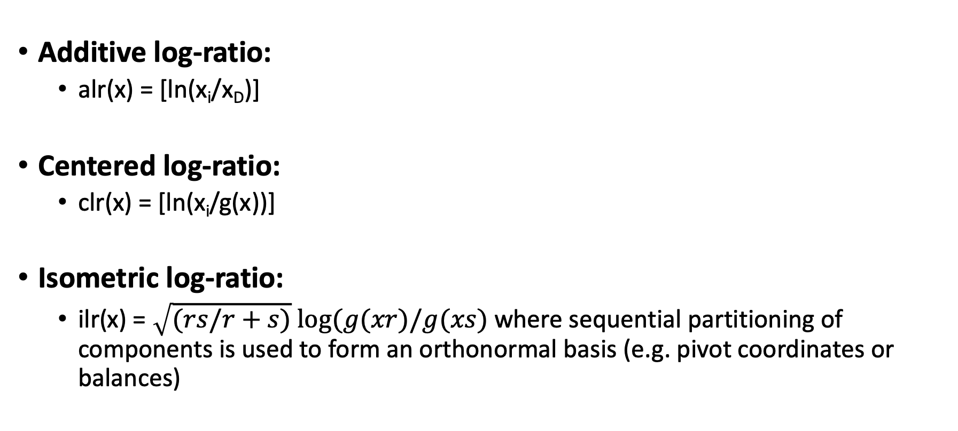
Log-Ratio Coordinates/Transforms
Additive log-ratio:
alr(x) = [ln(x_{i}/x_{D})]
Centered log-ratio:
clr(x) = [ln(x_{i}/g(x))]
Isometric log-ratio:
ilr(x) = $\sqrt{(rs/r+s)} log⁡(g(xr)/g(xs)$ where sequential partitioning of components is used to form an orthonormal basis (e.g. pivot coordinates or balances)

Slide 21
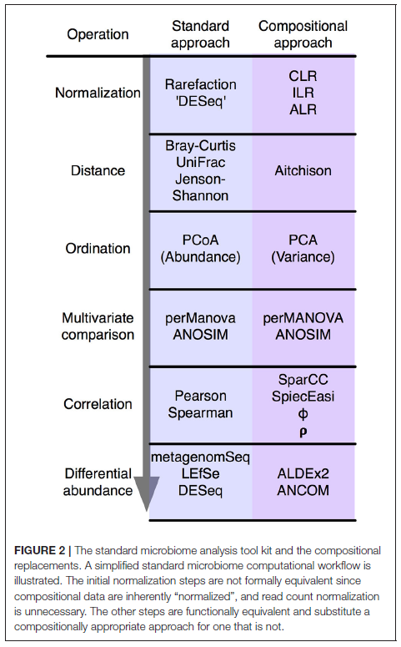
CoDA Microbiome Analysis Framework
Common analyses have compositional counterparts
Mature R packages
CoDA now recommend approach in QIIME2
Area of active development
Numerous simulations suggest perform as well or better than count-based normalization
Gloor et. al., Frontiers in Microbiology, 2017.

Slide 22

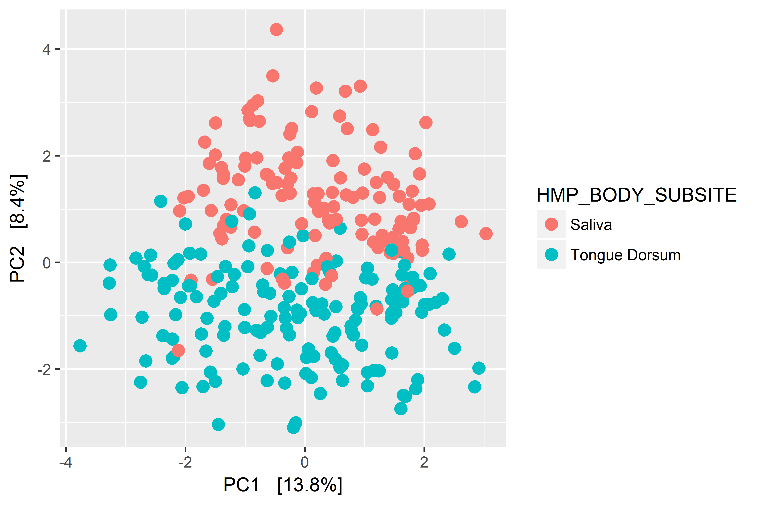
Ordination Using Aitchison Distance
CLR transform
ps_clr <- microbiome::transform(ps_hmp4, "clr")
Calculate Aitchison distance
ord_clr <- phyloseq::ordinate(ps_clr, "RDA")
Plot ordination
phyloseq::plot_ordination(ps_clr, ord_clr, type="samples", color="HMP_BODY_SUBSITE")
Data from the HPM 1 (16S V3-V5 primer set) obtained using the HMP16SData package in R.

Slide 23
CoDA Wilcoxon Test: ALDEx2
Pull out OTU table and condition
x <- data.frame(t((otu_table(ps_jm))))
y <- as.character(sample_data(ps_jm)$group_2)
Run ALDEx2 for 2-group comparison
jm_aldex <- aldex(x, y, denom = "iqlr")
Effect size plot
aldex.plot(jm_aldex, type = "MW", test = "wilcox")
Differentially abundant OTUs in murine stool according to foster genotype. BH-FDR <0.1 in red. OTUs < mean abundance (i.e. rare) shown in light grey.
Fernandes, Microbiome, 2014.

Slide 24
Limitations of CoDA
Logarithm of zero is undefined
General approach is to impute small value
Active area of research
Log-ratio transformation cannot be used to identify exactly which microbes are changing in DA testing
Some still recommend count models for metagenomics:
Large number of zeros distinctly problematic
Zero-inflated models may better reflect true structural zeros
Log-ratio normalization can be used to account for differences in library size

Slide 25
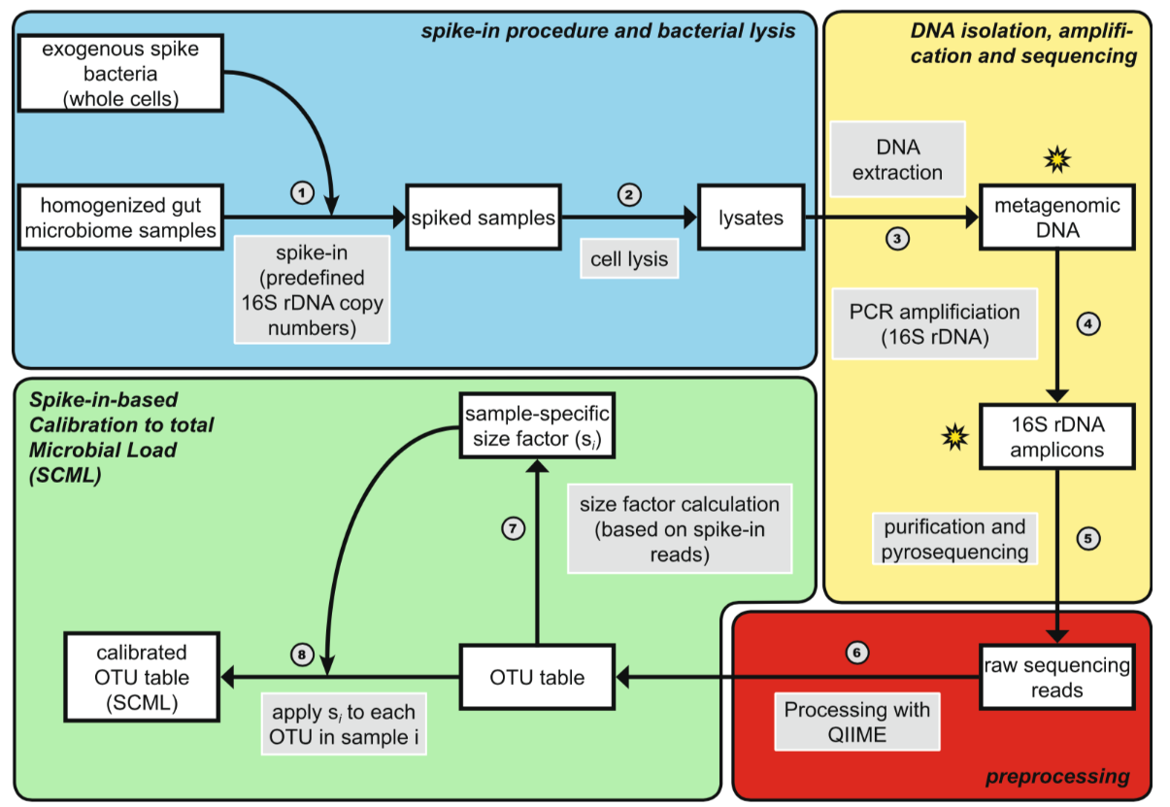
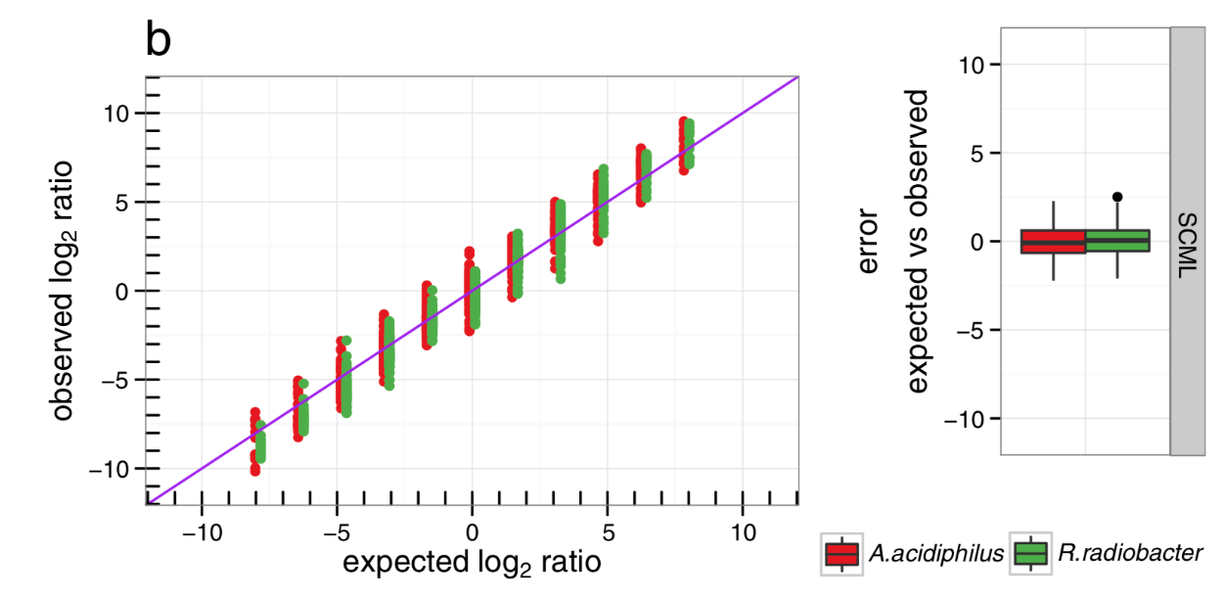
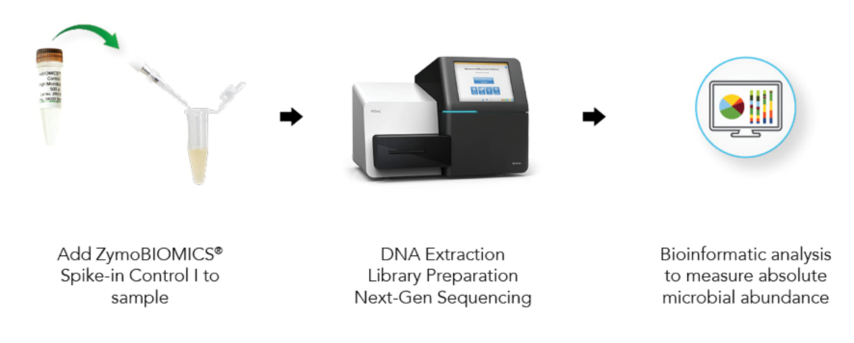
Normalization Via External Spike-Ins
Spike-in allow recapturing ratios of the taxon absolute abundances
Normalization analogous to additive log-ratio transformation
Stammler, Microbiome, 2016.

Slide 26
Part III. Approaches for Analyzing Longitudinal Metagenomic Data
Benefits of longitudinal study designs
Mixed-effects models for repeated measures data
Non-parametric alternatives

Slide 27
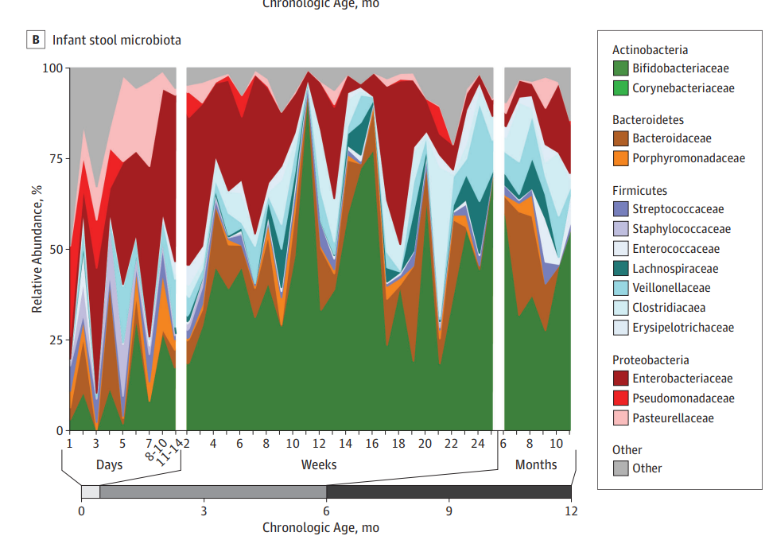
Longitudinal Microbiome Studies
Critical to understanding change over time
Many large, longitudinal studies due to low cost of 16S sequencing
Benefits:
Establish sequence of events
Examine within-subject change
Compare to previous time point
Baseline
Pre-intervention
Stool samples on 112 children. Pannaraj, JAMA Peds., 2017

Slide 28
Mixed-Effects Models
Longitudinal studies have time-dependent properties:
Inherent ordering of samples (i.e. time)
Statistical dependences that are a function of time (i.e. within-subject correlation)
Ignoring these properties can lead to wrong conclusions
Averaging repeated measures or using data from single points inefficient
Modeling repeated measures using mixed models allows for:
Proper accounting of time-dependent correlations
Proper estimation of standard errors
Can conceptualize as level 1 and 2 sub-models

Slide 29
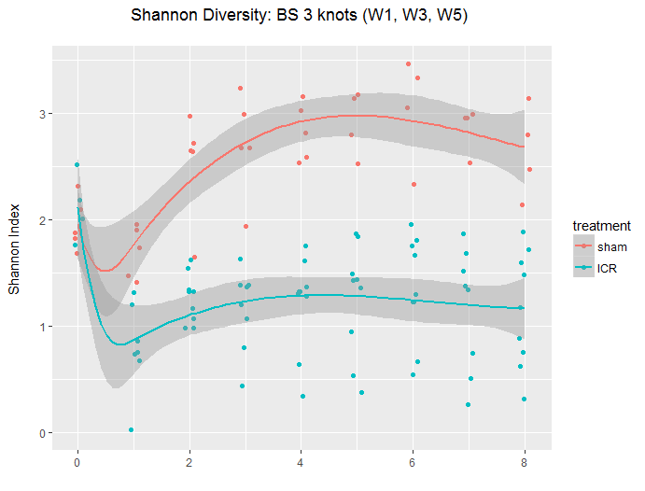
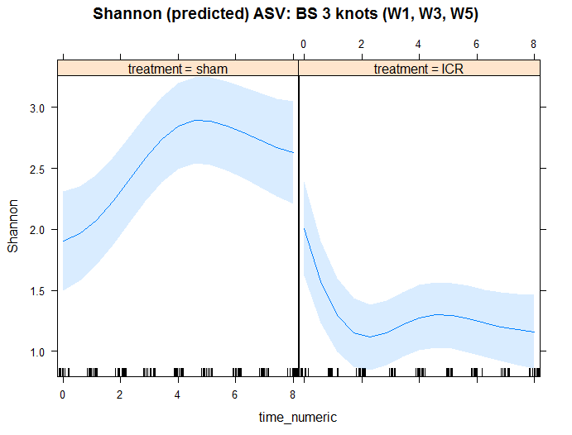
Modeling Alpha-Diversity: LMER
Raw data
Model predictions
LMER can be used to model linear trajectories and to test for group differences
Functional form can be expanded to model change over time more flexibly

Slide 30
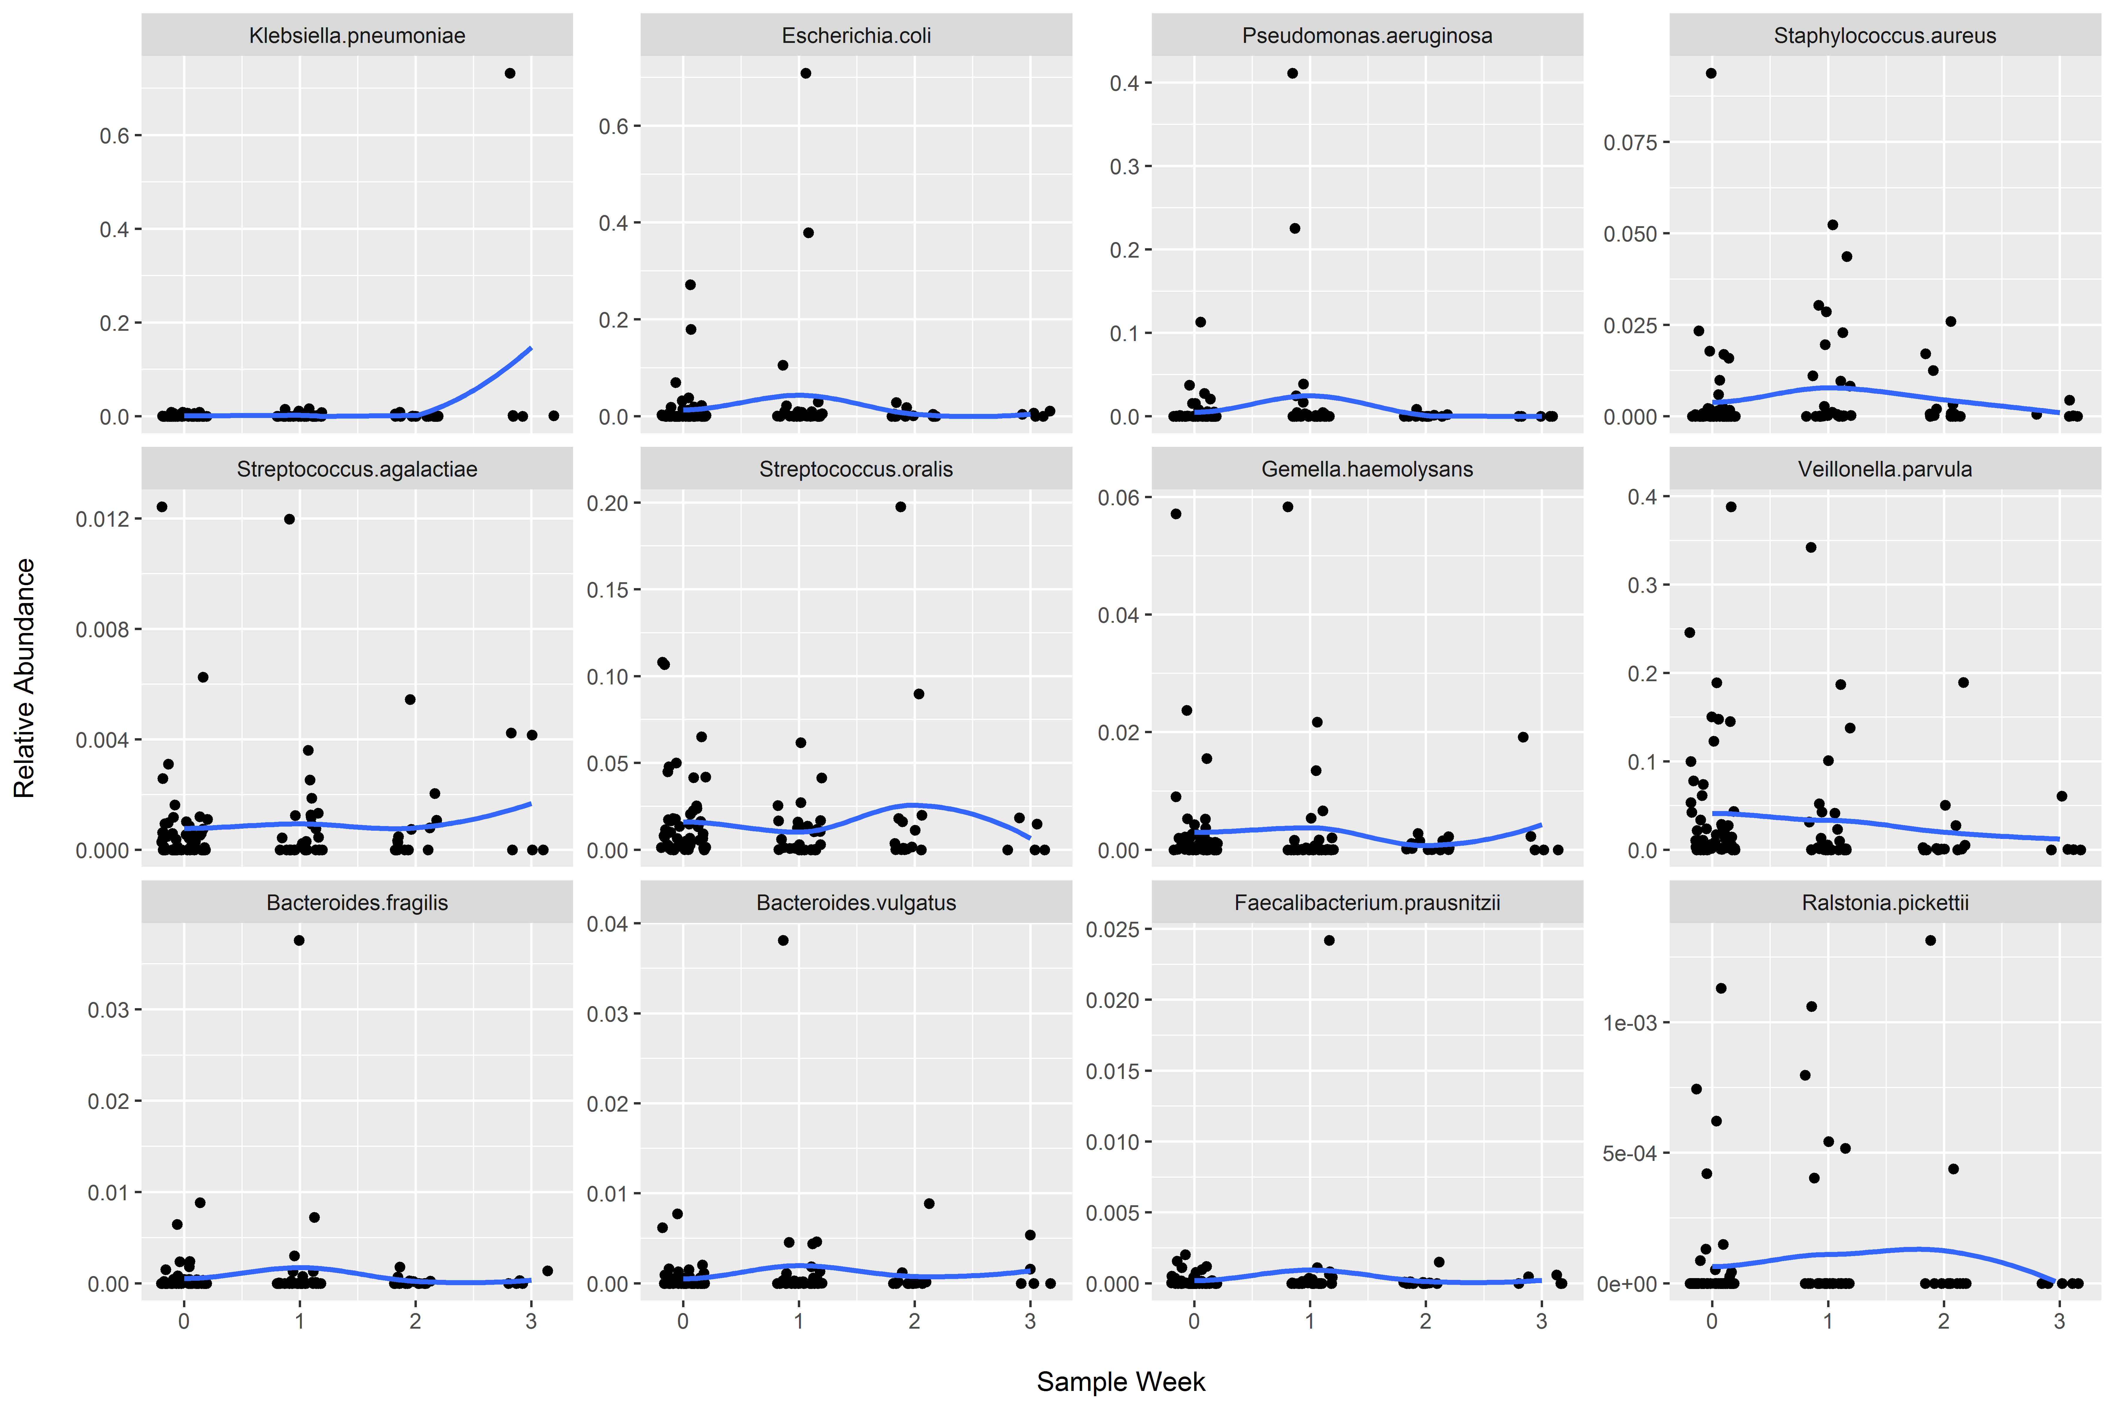
Outliers Abound in Microbiome Data!
Outliers are the rule not the exception!
Can bias regression parameters in parametric models
Can result in differences that are driven by relatively few samples
Primarily interested in identifying taxa that “consistently” differ in abundance
Truncating outliers common approach
Robust regression or non-parametric approaches may be useful
Oral microbiome samples following admission to ICU. Row 1 pathogens, Row 2 common oral, Row 3 common fecal.

Slide 31


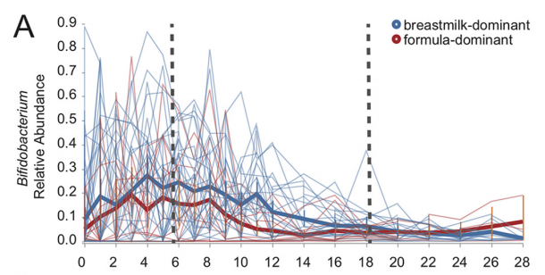
Random Forest Regression
Machine learning approaches to ID taxa predictive of change over time
Down weight outliers since goal is to identify features that improve prediction over all samples
Automatic generation of:
Train and test sets
Feature reduction
Model performance
Important features
Implement various learners
GBM, SVM, etc.
Control charts to examine change
Bokulich, mSystems, 2018

Slide 32
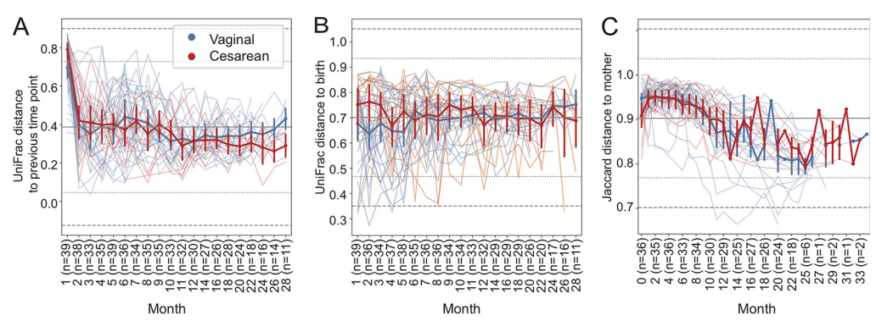
Beta-Diversity: First Differences
Calculates within-subject beta-diversity for each subject
Baseline can be previous sample, T₀, or other paired sample
Bokulich, mSystems, 2018

Slide 33
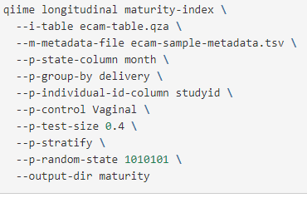
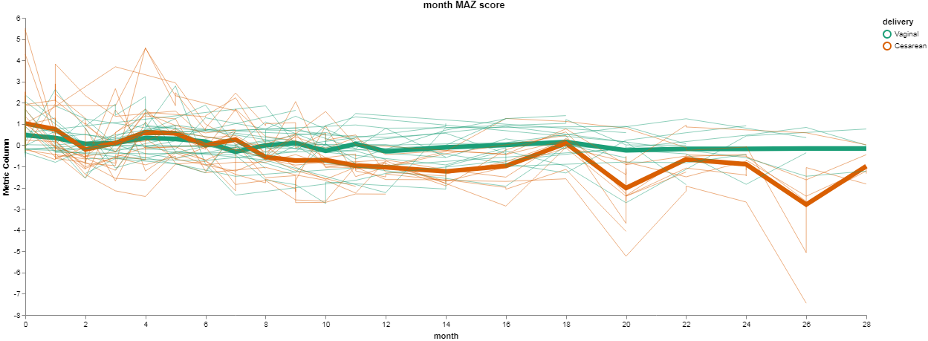
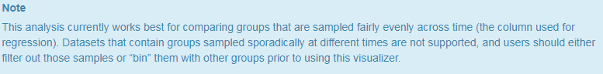
Microbial Maturation Index
Predicts subject age as a function of microbiota composition
Trained on a subset of control group samples then predicts z-score for all samples
Bokulich, mSystems, 2018

Slide 34
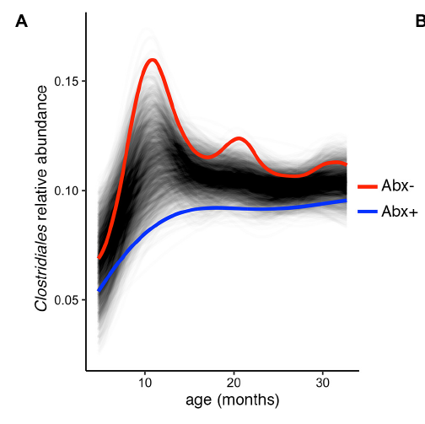
SplinectomeR
Uses loess splines to model change over time
Assume no distribution or functional form
Null distributions generated by permutation
Test whether two groups follow different trajectories over time
Permutes group labels
Test for difference between groups at defined intervals
Tests for non-zero change in single population
Permutes time points and compares to linear baseline
https://github.com/RRShieldsCutler/splinectomeR
Shields-Cutler, Frontiers in Microbiology, 2018.

Slide 35
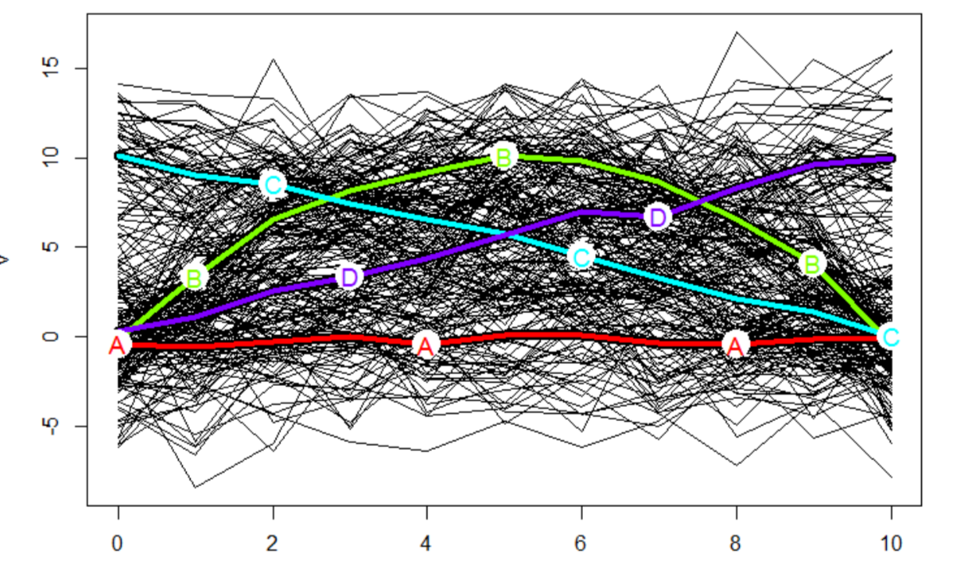
Longitudinal Clustering
Approaches exist to cluster longitudinal samples:
K-means clustering
Limited to one or two features
Functional PCA
Estimate smooth trajectories from sparse longitudinal data
Perform on taxon abundance table
Obtain multiple PCs
Suggesting groups with different change trajectories
Longitudinal k-means clustering as implemented by the kml R package. Mean trajectory of each partition colored.
Genolini, J. Stat. Software, 2015

Slide 36


Part IV. Microbiome Meta-Analyses
Qiita for metagenomic meta-analyses

Slide 37
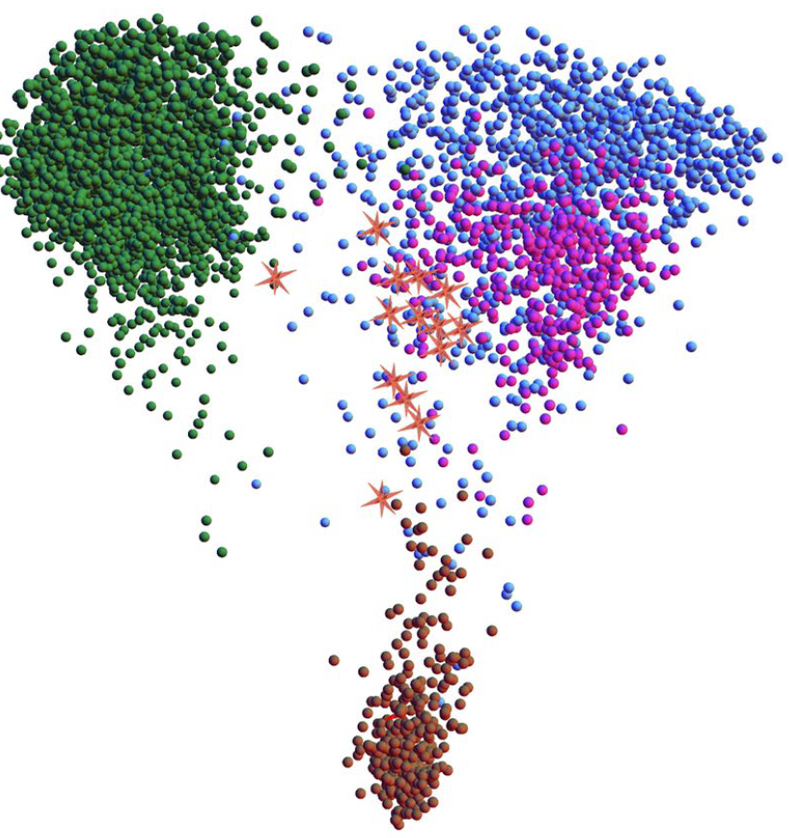
Why Microbiome Meta-Analyses?
Examine your samples in relation to other similar studies
Compare to various control populations
Assess reproducibility of results across studies
Consistency of results
Gain insight into reasons for discrepancies
Compare results using standardized workflow
More data should bring more insights…
IBD Recurrence Risk

Slide 38
Why Qiita?
Database of >150,000 public samples (500k total)
Metadata conforming to MIxS standards
Standardized workflows using user-friendly web interface
Analyses start from primary data (e.g. fastq)
Redbiome to query metadata fields
Other benefits:
Computing on UCSD servers, ENA-EBI data deposition, projects kept private and/or make public after embargo, use as GUI microbiome workflow for 16S and shotgun metagenomics, QIIME2 analysis plug-ins, output processed data, other sample types, metadata templates, …
Gonzalez, Nature Methods, 2018.

Slide 39
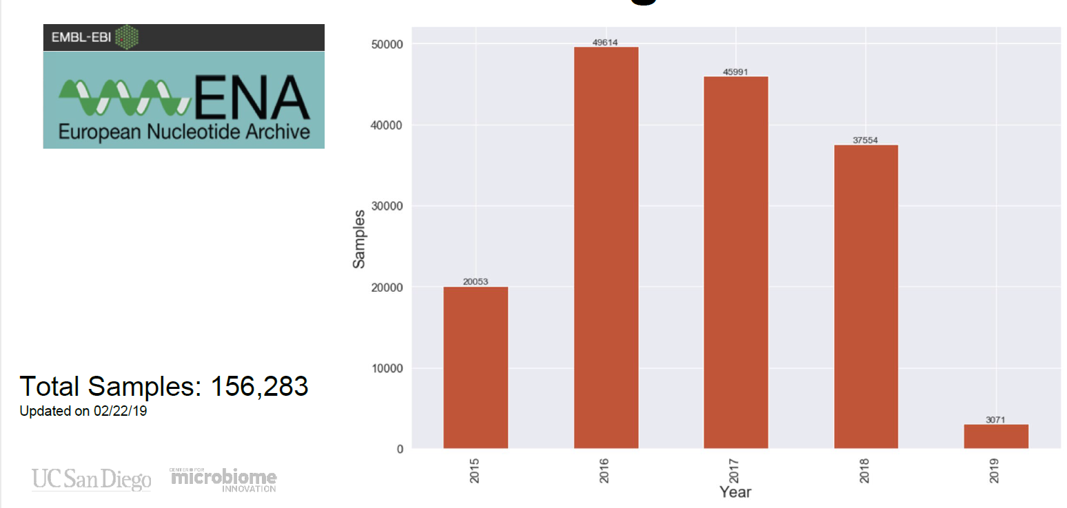
Publically Accessible Samples

Slide 40
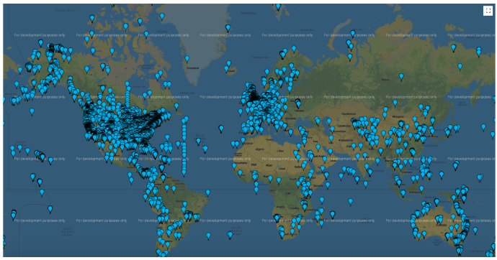
Geographic Diversity
Figure generated on 3-15-18

Slide 41
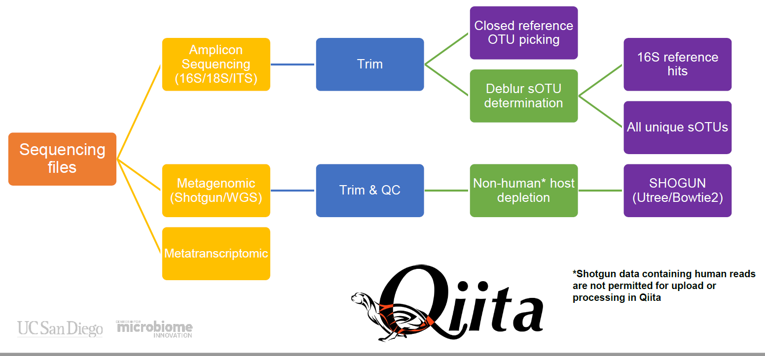

Qiita Metagenomic Read Processing Overview

Slide 42
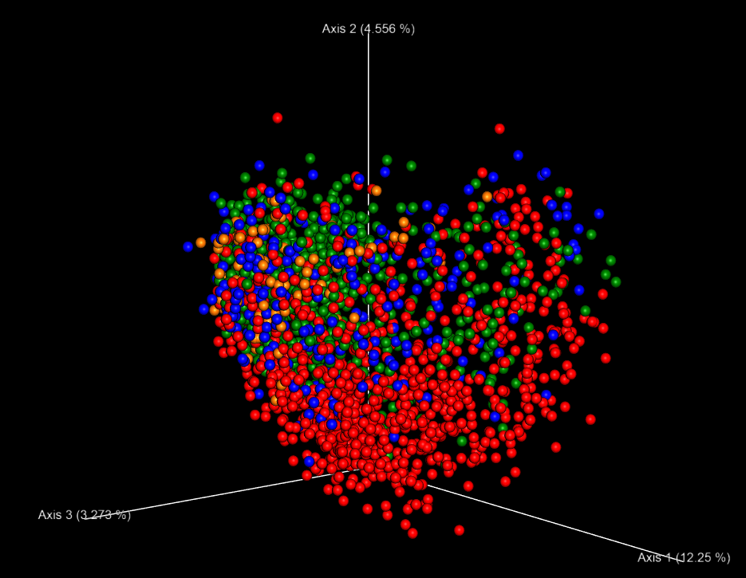
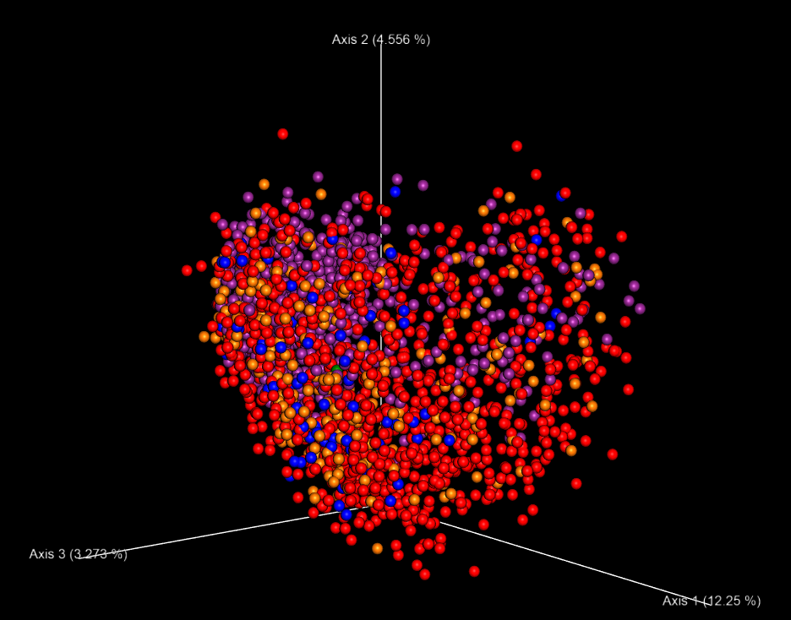
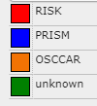
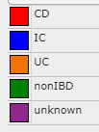
Ordination for Example IBD Meta-Analysis
Cohort
Diagnosis
Next steps: overlay your samples, restrict to those with calprotectin levels, test for differences in specific taxa, etc..
https://qiita.ucsd.edu/analysis/description/15093/

Slide 43
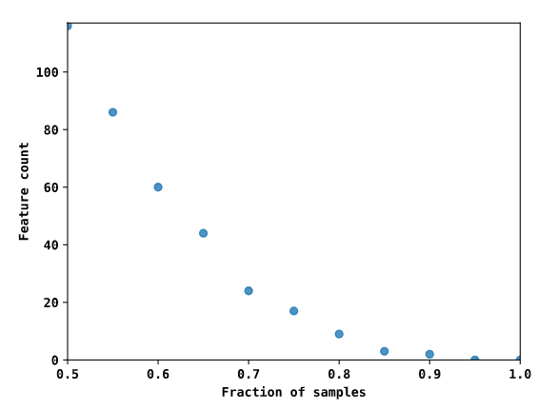
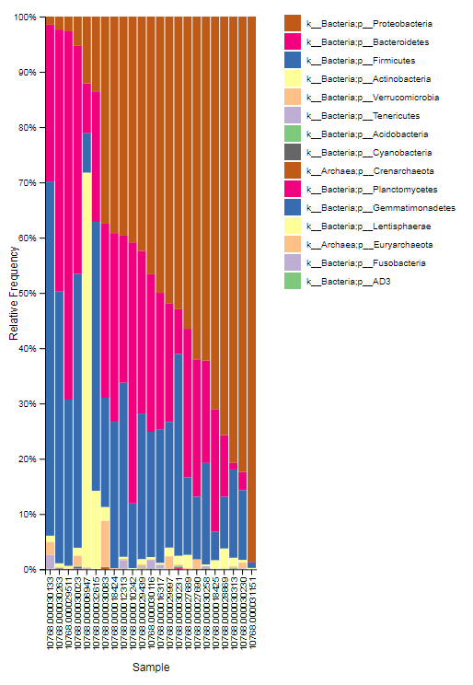
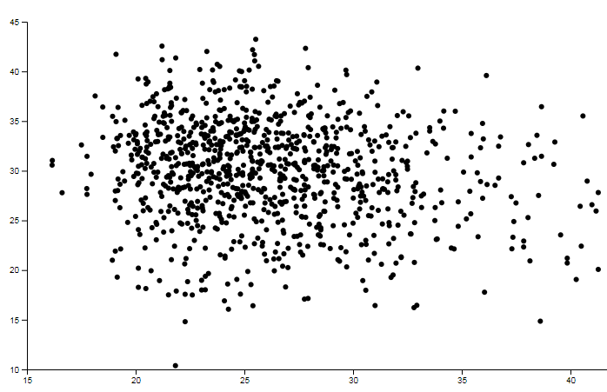
Quickly Generate Visualizations
Taxonomic Compositions
Core Taxa
Alpha-Diversity Correlations
Faiths PD
https://qiita.ucsd.edu/analysis/list/
BMI

Slide 44

Summary Points
ASVs should replace OTUs for marker gene studies
NGS returns compositional counts
Compositional data analysis methods should be considered
Impact of zeros on CoDA approaches active area of research
Normalization assumes removed compositional constraint
Longitudinal designs confer many benefits
Many ongoing methodological developments
Integrating samples across studies may help advance understanding of the role of the microbiome in human health

